Slide 1
HCC Totality Training New Supplier

Slide 2
Training Agenda
Totality Overview
Totality Importance
Roles and Responsibilities
Compliance Requirements
Totality Resources
Supplier Navigation
Data Template (Download & Completion)
HCP Search & New HCP request
Data Integrity on template uploads
Upload (Document & Template)
Errors (Notification/Validation/Correction)
Activity Report and Close out
Upload Review and Data Deletion
US Activities with OUS HCPs (Cross Border Interactions)
Project Closeout

Slide 3
Totality Overview
Totality is a centralized data management system that provides review and approval of projects involving engagement with Health Care Professionals/Providers (HCPs), Government Officials, Customers, and Medical Institutions
Scope: All payments made to HCPs from a U.S. Johnson & Johnson budget
Prescribers | Doctors, Nurses, Practitioners, Physician Assistants
Acquires | Hospitals, Health Systems, Procurement Professionals, Clinics, Managed Care Organizations, Pharmaceutical Benefit Managers (PBMs), Group Purchasing Organizations (GPOs), Formulary Committee Members, Purchasing Agents
Influencers | Medical Administrators, Universities, Purchasing Agents, Formulary Committee Members, Nurses, Health Economists, Key Opinion Leaders (including Scientists and/or PhDs), Medical Societies, Advocacy Groups, Commercially contracted customers and their subsidiaries (e.g., Medco/UBC)
Two Instances of Totality:
Internal Portal: Review & approval – provide visibility to all documentation & value exchange uploaded by suppliers
Supplier Portal: Used by suppliers to upload value exchange data and required compliance documentation
Why Use Totality?
Supports transparency initiatives and federal/state reporting requirements
Central repository for maintaining compliance documents in support of HCP transactions
Unique J&J HCP ID # used to track and report all HCP value exchange

Slide 4
J&J HCP ID for Reporting
J&J HCP ID is a unique identifier for Johnson & Johnson. The HCP ID is used to aggregate value transfers to a Practitioner from multiple data sources (Procurement, Concur and Third Party Data)
HCP Heavy
Full data add process with data matching & unique identifiers for Individual HCPs and Institutions who are required to meet statutory and voluntary requirements which are subject to full HCC and business policy controls.
J&J ID is required for all Practitioners, Mid-Level Practitioner, US Institutions, Nurses and Pharmacists in MA, DC, VT, NV
HCP Light
Simplified data add process for individuals still subject to internal audit reporting and full HCC and business policy controls. No need to assign a unique J&J ID number from the Customer Master system.
Examples include: non-reportable attendees or consultants (office admins, Individuals outside of the US. etc.)

Slide 5
HCP Reportable & Non Reportable (US)
Recipient Profession | Recipient Job Classification | Reportable – General | MA, DC, VT, NV
Practitioner | -MD – Medical Doctor -DCM – Doctor of Chiropractic Medicine -DMD – Doctor of Dental Medicine -DDS – Doctor of Dental Surgery -OD – Doctor of Optometry -DO – Doctor of Osteopathy -DPM – Doctor of Podiatric Medicine -DVM – Doctor of Veterinary Medicine -Resident | Yes | Yes
Pharmacist | -Pharm D – Doctor of Pharmacy -RPh – Registered Pharmacist | No | Yes
 | For activities involving HCPs from OUS countries, country-specific requirements determine whether an entity is reportable under external reporting requirements. Contact Global Transparency Reporting (GTR) to confirm what is in scope for reporting for each applicable country.

Slide 6
HCP Reportable & Non Reportable (US)
Recipient Profession | Recipient Job Classification | Reportable – General | MA, DC, VT, NV
Mid-Level Practitioner | -APRN – Advanced Practice Registered Nurse -NP – Nurse Practitioner -PA – Physician Assistant | Yes | Yes
Mid-Level Practitioner | Dental Therapist | No | Yes
Nurse | -BSN – Bachelor of Science in Nursing -LPN – Licensed Practical Nurse -RN – Registered Nurse | Yes | Yes
Other Professional | -PhD – Doctor of Philosophy -PsyD – Doctor of Psychology -Optician -Counselor -Social Worker -Technician -Student -Non-licensed Other Professional -Administrative Staff | No | No

Slide 7
Why is Totality Important?
Totality serves as J&J’s system-of-record for value exchanges made to Healthcare Professionals (HCPs) and a critical control mechanism for J&J’s Healthcare Compliance (HCC) program.
Vital to J&J’s compliance with External Reporting Requirement Regulations
US Open Payments (“Sunshine Act”)
Program implemented in accordance with physician and teaching hospital payment reporting provisions of the Affordable Care Act (ACA) of 2010
Requires health care manufacturers to report to the federal government certain payments and other exchanges of value (e.g. food and beverage, travel expenses) provided to U.S. Healthcare Professionals (HCP) and U.S. Teaching Hospitals.
Information is then posted by the government on a public website
US Open Payments Impact
Tight timelines for Johnson and Johnson to prepare reports for submission requires all information be uploaded ON TIME
Information in Totality will be used to compile the Open Payments reports, as well as other disclosures such as state reporting and company transparency reports
Inaccurate information may result in non-compliance with applicable laws and potential penalties for our company, and lead to dissemination of inaccurate information to the public regarding our payments and other value transfers to HCPs

Slide 8
US Activities with OUS HCPs (Cross Border Interactions)
In some instances, a US Business (e.g., Global Commercial Strategy Organization) may plan activities that span international borders based on the attendees. An assessment of the laws, regulations, and industry codes for all countries involved in a particular interaction is necessary to ensure such local guidance is adhered to, including but not limited to:
All transfers of value involving OUS HCPs must be uploaded into Totality. Why? There may be variations in standards, laws, and regulations regarding the requirements of cross border activities, such as Transfer of Value reporting requirements. Totality TOV information is necessary for our internal team to assess these regulations for each applicable country.

Slide 9
Roles and Responsibilities
Supplier
Complete totality training prior to signed contract and annually
Ensure executed contract & J&J Purchase Order is in place before work begins
Understand compliance requirements
Ensure systems and processes capture required data, documentation, and all deliverables
All value transfer MUST be uploaded. (Heavy and Light) within the specified timeline (refer to slide 10 for timelines)
Validation of data
Attest when deliverables are complete
Complete, Accurate, and Timely Completion of Tasks
J&J Project Owner
Program initiation for internal HCC review and approval
Execute supplier contracts
Ensure supplier is aligned with compliance deliverables
Review of deliverables and uploads to ensure completion & accuracy
Ensure proof of payment is provided/documented
Closing the project

Slide 10
Compliance Requirements
Five key elements that internal project owners must provide for a clear audit trail:
Legitimate Business Need
Clearly identified goals and objectives
Fair Market Value
Written Contract
Evidence of Services Performed
Required documentation by project completion
Verification Checks – Required for all US HCP’s
Upload dated screenshot for OIG/EPLS/State License checks
Project Deliverables/Proof of Service
Dually executed J&J HCP agreement
Proof of payment(s) made, e.g., invoices preferably in local currency
Any additional documentation required by your J&J Project Manager

Slide 11
Upload Requirements
Data Template Upload Timeline Requirement:
One-Time events – 30-days after project completion
High volume projects/events – Monthly (30-days after month close)
All other projects that span across the year – Quarterly (30-days after quarter close)
REMINDER: Q4 data is always due January 30, 20XX. Anything uploaded after the due date is considered “Late Data” and subject to government penalties.
Please reach out to your J&J Project Manager or Totality Expert for the respective sector that you’re working with for any additional support.

Slide 12
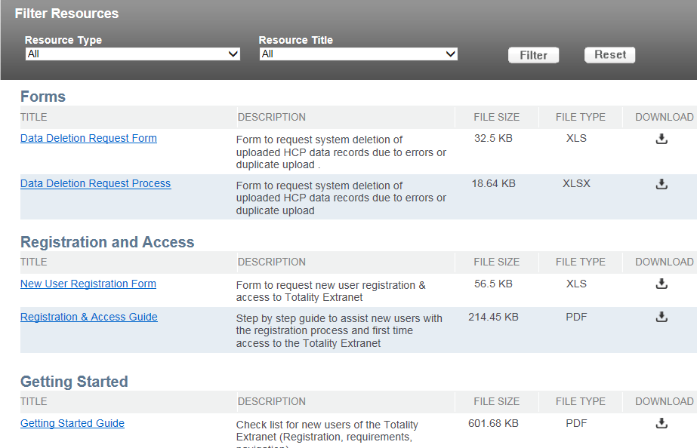
Totality Supplier Resource Site
Supplier Totality Process flow
Key Information
Registration & Access
New User Registration Form
Registration & Access Guide
Getting Started & Training
Check list for Totality Users
Recorded Totality Overview Training
Other Information Available:
Additional Training Documents, Forms, Compliance Deliverables, Reference Guides, and Report Instructions
To view these resources, visit: http://www.totalitygatewayresources.com/

Slide 13
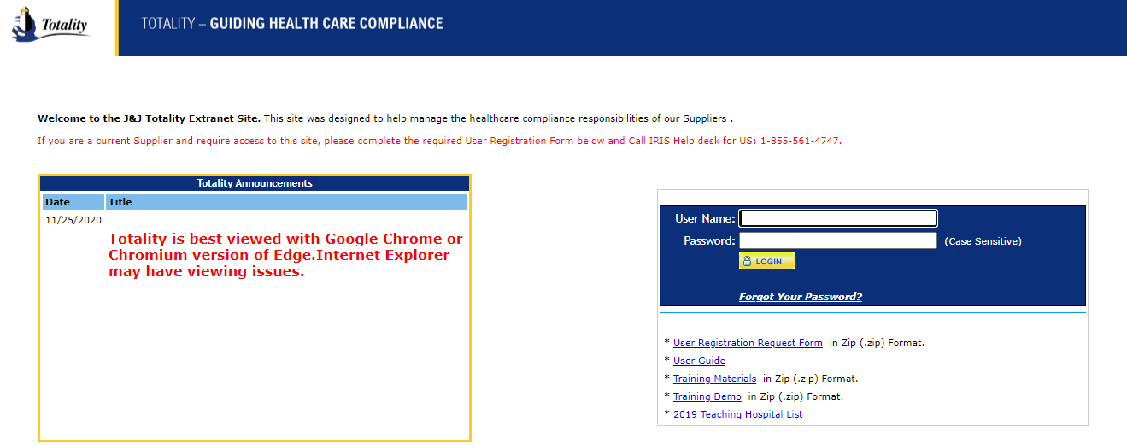
Supplier Login
Key Points:
New users will need to complete and submit the ‘User Registration Request Form’
Upon completion you will receive a welcome email with login information (User Name = Email Address)
Once you login, you will be asked to verify your Supplier Name & Supplier Number.
You can obtain your J&J Supplier Number from a Purchase Order, Check, or your J&J Project Manager
If your account is inactive, email: TG@PRDUS.jnj.com to reactivate your account.
Totality is best viewed with Google Chrome or Chromium version of Edge. Internet Explorer may have viewing issues.
To access the site, visit: https://totalitygateway.jnj.com
Enter User Name (Email) & Password – Select Login
Latest News & Announcements
STEP - 01
Getting Started Information – Request Form & Training Materials

Slide 14
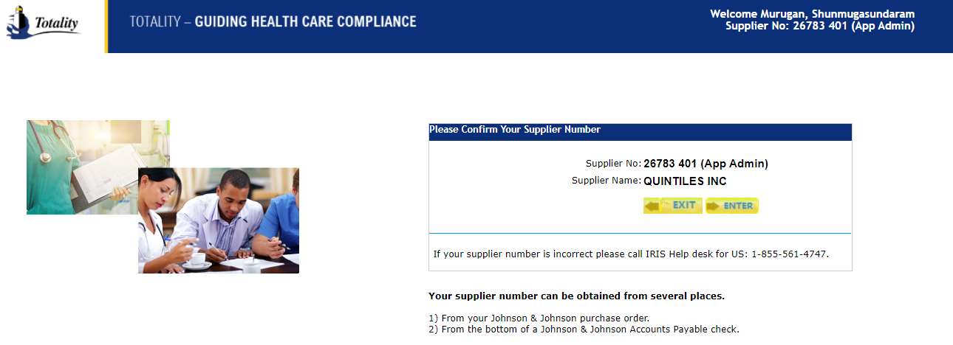
Supplier Homepage

Slide 15
Homepage Menus
View all “Active or Closed” Projects by clicking here
Download data templates to populate value transfer data, request data deletion and HCP Bulk Look Ups
View Upload Activity/Error Reports. You may access up to 12 months of historical data
Click here to view outstanding error lines
Select this if need to manually reset password
This section allows to Search for HCP (HCP ID) or request to add a new HCP
Click to upload data templates, compliance documents, and to complete project attestation
To request an activity report to view data upload activity click here.
Supplier Admins can click here to search Upload Activity against Supplier Number

Slide 16
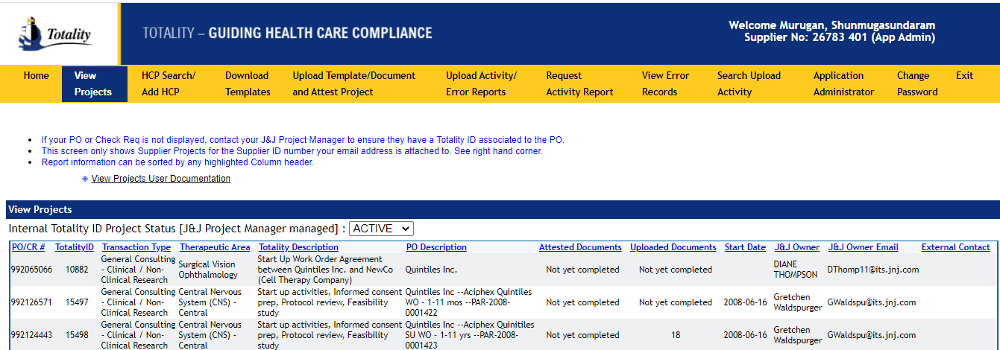
View Projects
Click to filter on Active or Closed Projects
Key Points:
Ability to view all Active & Closed projects associated with your supplier ID
Ability to view all Purchase Orders associated with an individual Totality ID Number
Note: If the PO or CR number you entered does not show up in your list, contact your J&J Project Owner to ensure there is a Totality ID associated with your PO or CR number

Slide 17
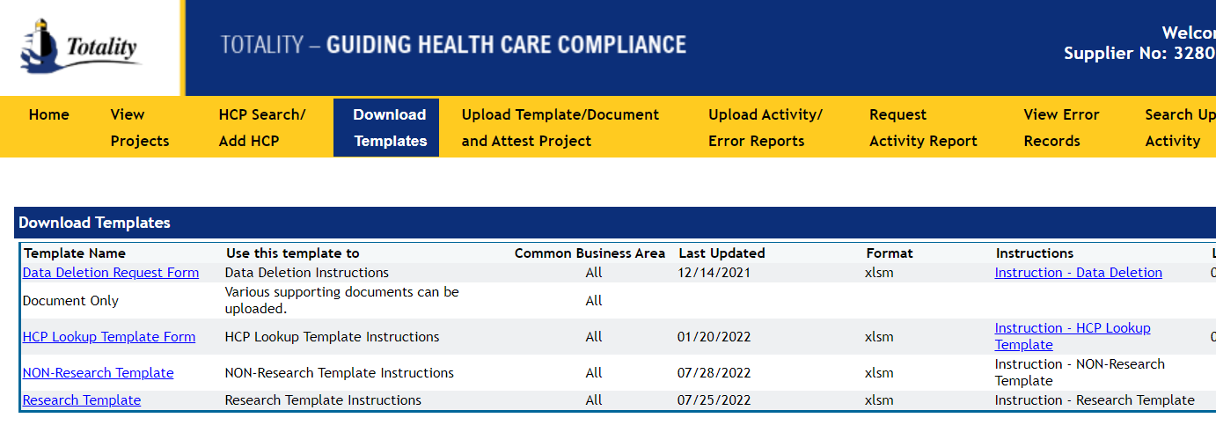
Download Data Template
Template Name, When to Use, and Common Business Areas
Instructions for Completion
Key Points:
Make sure to select the appropriate Data Template type
Instructions can be found under the “Instructions” column by selecting the blue link associated with each data template
Visit the Supplier Resource Site under “Instructions & Reference Guides” for detailed instructions

Slide 18
Completing Data Template
All Data Templates include two buttons to perform the following functions:
Verify Data: Performs validation for required fields and formatting errors
Prepare File for Upload: Performs validations & converts the data into the required CSV format
NOTE: Be sure to change your Excel security settings to “Allow all Macros” – you will not be able to perform the validations/upload without.
Purchase Order/Check Requisition is required and must be linked to a valid Totality ID
Note: Only One PO/CR per template
Title Bars:
Names of required fields for data upload (all fields are required unless otherwise noted
Roll Over column heading for general instructions
Note: All HCP Payments must be associated with a J&J HCP ID
Pick List: Available for certain required fields – ability to select data from a list

Slide 19
Completion of Templates
All fields are required for each line item, including the PO or CR #
Only one PO per Data Template
Include only HCP-related expense information
HCP:
Don’t include Jr., Sr., III, etc. to the Last Name
Do not put Middle Initial in any other field other than MI
Classification – ensure credentials are correct for Practitioners (i.e., should be MD DO, OD, DOP, etc.)
MDs being added with a temporary HCP ID – must have a J&J HCP ID (do NOT leave BLANK)
Meals must be broken out individually by line
Values must be in US Dollars and NO commas (,) or dollar signs ($) can be used

Slide 20
Completion of Templates
Multiple projects can be included on a template, as long as it’s for the same PO
Leave fields blank if there is no payment information - do not enter Zero
Expenses:
Company Paid Expenses – Expenses Supplier/J&J paid on behalf of HCP
Direct Reimbursable Expenses – HCP reimbursed for expenses paid out of pocket
Miscellaneous Expenses – use only for true miscellaneous expenses – use sparingly
Parking, gas, mileage should be included in Ground Transportation
Tips should be included with related expense category such as meals or lodging
ALWAYS run “Verify Data” prior to loading a file to validate for format & required data errors
Detailed instruction found in the link: https://totalitygateway.jnj.com/tpextranet/dwnldTmplt.do

Slide 21
Understanding Reporting Requirements
All value transfers provided by the third party must be uploaded.
Data is used for: External Reporting Obligations, including: Open Payments reporting, State reporting and Outside US reporting from a US J&J budget (e.g., cross border activities)
Open Payments reporting requires J&J to name the Institution or Individual receiving the payment AND the Individual or Principal Investigator who performed contracted task regardless of their credentials

Slide 22
HCP Search and/or Request New HCP
Selecting the best J&J HCP ID is the critical driver for federal and state reporting.
The search is done for Professional and Institutions:
Professional : The best identifier to use for an individual HCP is their National Provider Identifier (NPI) number.
Institutions : The best identifier for a Teaching Hospital is their Tax ID (EIN) number.
It’s important to ensure that the entity is a reportable Teaching Hospital or a licensed US practitioner who received a value transfer from J&J.
When selection of HCP ID is incorrect, it can and has resulted in HCP disputed transactions through Open Payments.
Let’s work together to ensure the correct selection is made in order to decrease HCP disputes in the future

Slide 23
Payment Arrangement / Institution vs Individual
Institution / Entity Name
Institutions/Entities can be:
Hospitals, Academics Institutions, Group Practices, Practice Name
NOTE: Some Individuals have set up Legal Entities using their given name such as: Dr. John Doe, LLC, Dr. John Doe, PC, etc.
Legal Entities will have a Tax ID# instead of the Individual’s social security number
If not in the system by LLC, PA, Inc – then add it to Totality
Only select Institution for a Legal Entity if the Practitioner or Consultant has given you the Tax ID# for the Legal Entity. Otherwise, report the payment arrangement as paying an Individual.

Slide 24
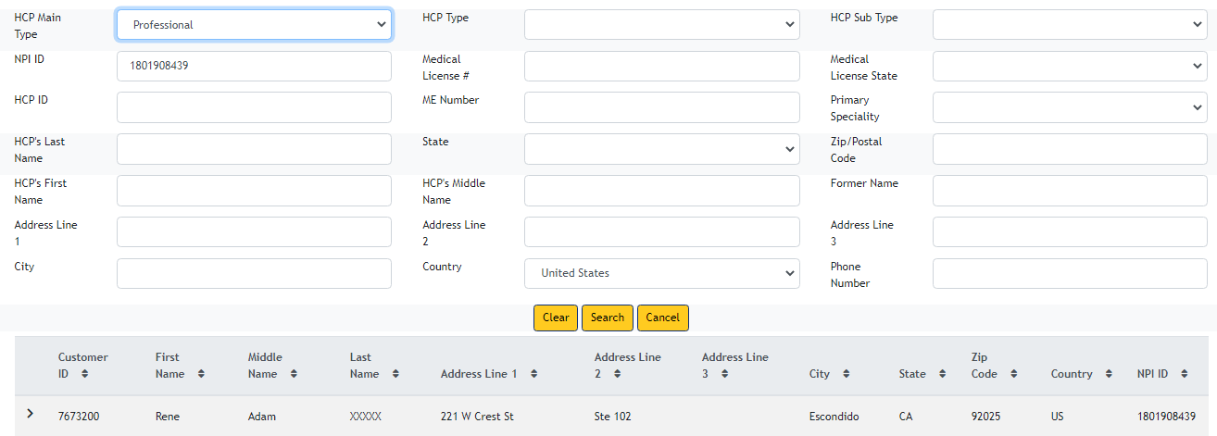
HCP Search | Professional | NPI ID
Always
Prioritize using NPI number to search HCP
NPI number is unique for HCPs in the US. It is easier to conclude referring to the NPI number.
----------------
It is very important to collect the NPI number of each HCP during registration, reservation and in sign in sheets
In Totality, look up the JNJ HCP ID using the NPI # of the licensed HCP. To obtain the NPI number, use https://npiregistry.cms.hhs.gov/search. The HCP may have licenses in multiple states. The address listed for the HCP may not be an exact match. Do not submit an HCP Add request to add additional addresses.
If there is not a match using NPI#, complete the HCP search in Totality using Medical License # and License State or by Last Name and State.
Often, there are HCPs that have the same name but have different specialties, degrees, etc. Confirm the selected HCP aligns with correct specialty, degree type, etc.

Slide 25
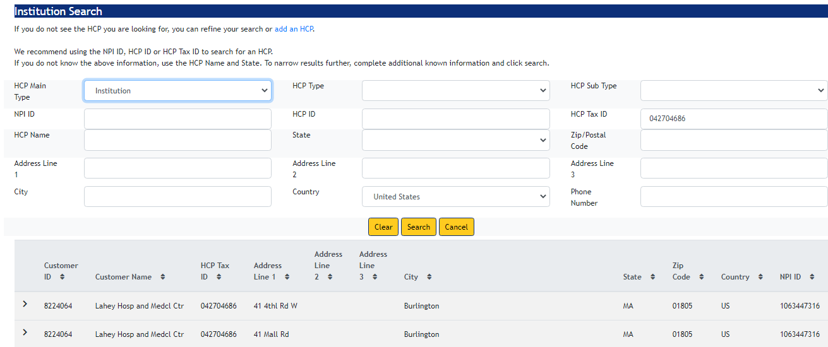
HCP Search | Institution | HCP Tax ID
For Institutions, always look up JNJ HCP ID using HCP TAX ID and state of the institution
In Totality, look up the JNJ HCP ID using the TAX ID and the state of the institution. If the Tax ID returns a match, please use the corresponding JNJ HCP ID in your transaction.
The address listed for the HCP may not be an exact match.
Do not submit an HCP Add request to add additional addresses.

Slide 26
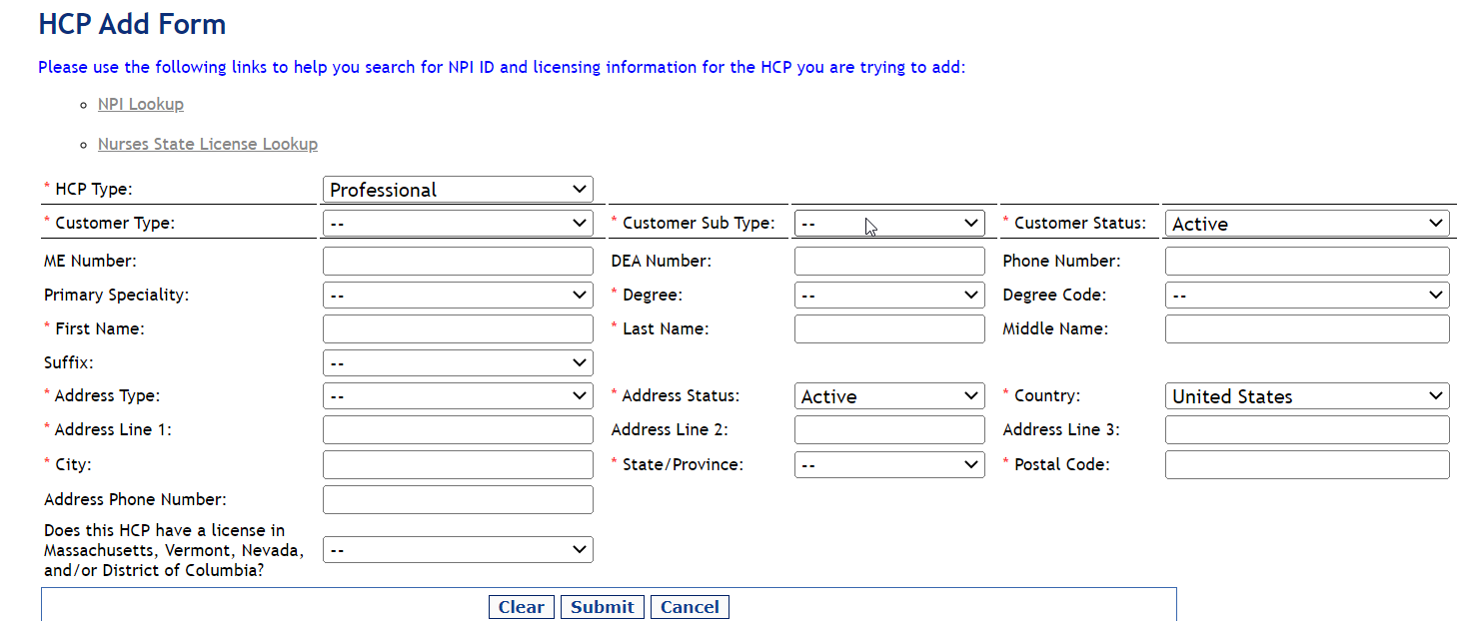
HCP Search | Add HCP
Key Points:
Prior to searching, you must ‘Accept’ the IMS & AMA terms & conditions to proceed
Confirm the HCP you select is an exact match based on key information (Address, License #, etc.)
HCP add requests take 7-10 business days to process
Visit the Totality 3rd Party Portal ‘HCP Search/ Add HCP’ section for step-by-step instructions to search or add HCPs
Do not submit an HCP Add form to add additional addresses

Slide 27
Data Integrity: Do’s & Don’ts
DO – Search for a J&J HCP ID for every HCP with a “Heavy” status (Practitioner, Mid-Level Practitioner, Resident) and HCPs in identified States (MA, VT, NV, D.C.) as “Light” (Technician, PhD, Office Staff, etc.)
DO – Input Middle Name and/or Middle Initial in the “Middle Initial” field only
DON’T – Include Middle Name with First or Last Name fields

Slide 28
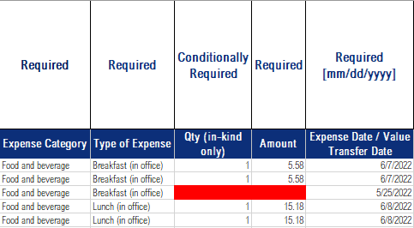
Data Integrity: Do’s & Don’ts
DO – align the HCP Category Type with the HCP’s Degree/Classification
DON’T – mismatch the HCP Category Type and the HCP’s Degree/Classification
DO – identify the HCP/Individual when a meal or travel is provided
DON’T – exclude meal or travel amounts when it’s provided to HCP

Slide 29
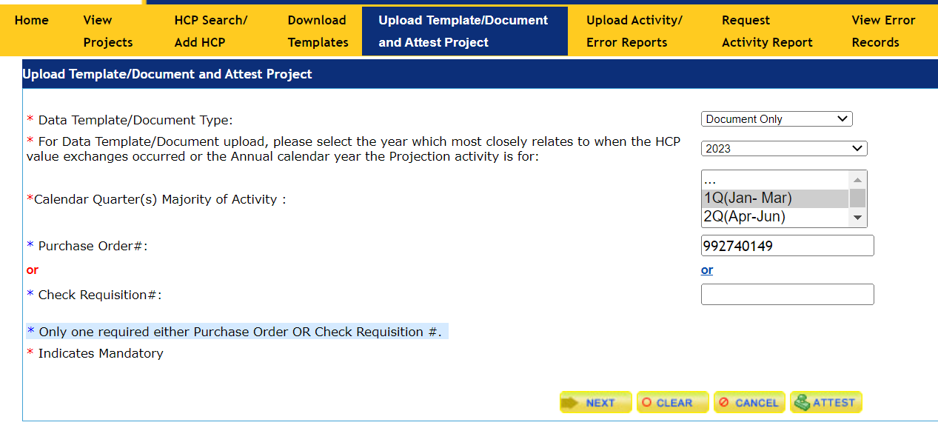
Document Only
Select Document Only from the Drop Down Menu
Select the Year and Quarter of when the HCP Value Exchange Occurred
Enter Purchase Order # or Check Req. #
Click ‘Next’

Slide 30
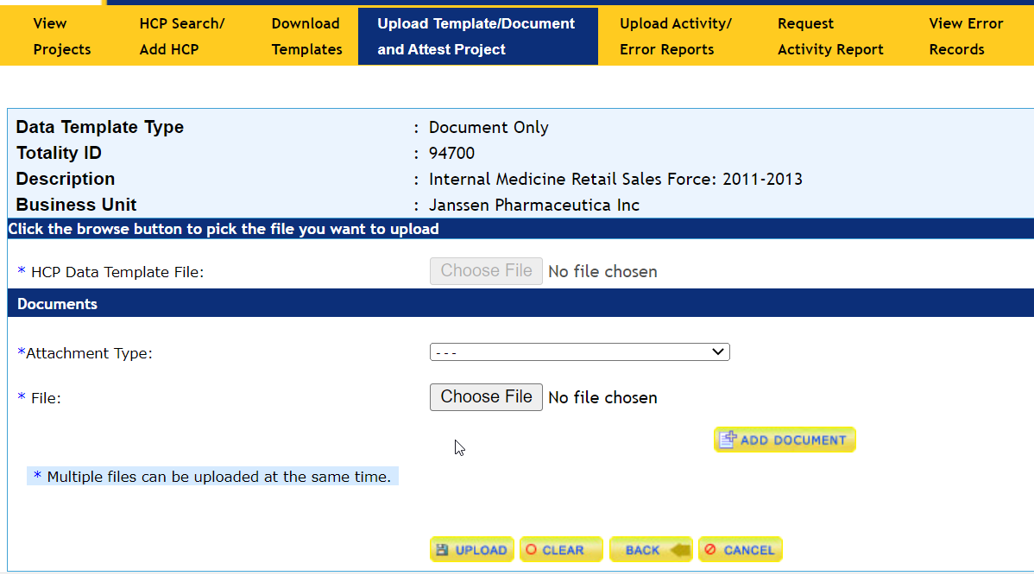
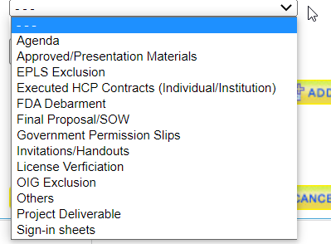
Document Only
Select Attachment Type from Drop Down Menu
Select Choose File to locate and select applicable file attachments
Click Upload
Only .txt / .gif / .jpg / .tif / .xls / .doc / .ppt / .pdf / .html / .htm / .rtf format is allowed.

Slide 31
File Upload: Template
From the Menu– select ‘Upload Data Template/Document & Attest Project’ tab
Select the Data Template from the Drop Down Menu
Select the Year and Quarter of when the HCP Value Exchange Occurred
Enter Purchase Order # or Check Req. #
Click ‘Next’
Common Errors:
Invalid PO/CR – PO not linked to a valid Totality ID
Confirm PO/CR Number entered is correct
Contact J&J Project Owner to ensure PO/CR is connected to a Totality ID
Supplier ID associated with the email/user name is not consistent with the Supplier ID associated with the PO
Contact Totality Helpdesk for resolution
Create a new User ID consistent with the Supplier ID on the PO

Slide 32
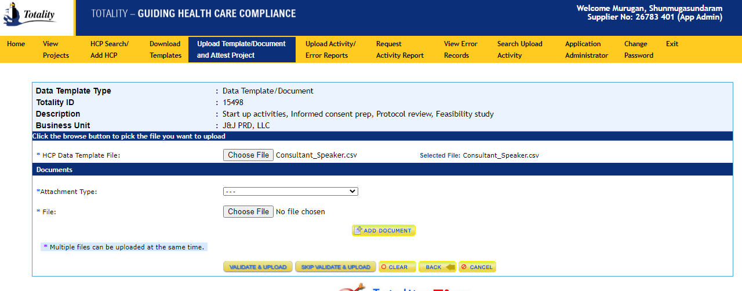
On Screen Data Validation
Click Validate and Upload

Slide 33
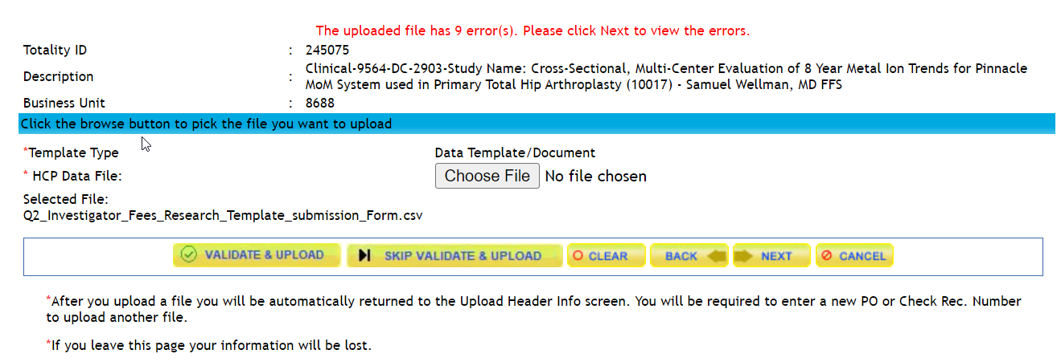
On Screen Data Validation

Slide 34
On Screen Data Validation
Click Down Arrow to see Suggested Value List
Choose the correct selection to add value to form

Slide 35
On Screen Data Validation
Choose the correct selection to add value to form
Click to Accept the selected values in error rows above and upload file
After selecting the correct suggested value for each error row, when you click “Accept Suggested & Upload”, the template file will be overridden and updated to the values selected.

Slide 36
File Upload Completion
Successful notification of processing upon submission
You will receive an automatic email notification that your file was process successfully or if there were errors
File uploads are processed Monday – Friday 6:00 AM to 6:00 PM EST
All files received outside this timeframe will be queued and processed at the next regularly scheduled interval

Slide 37
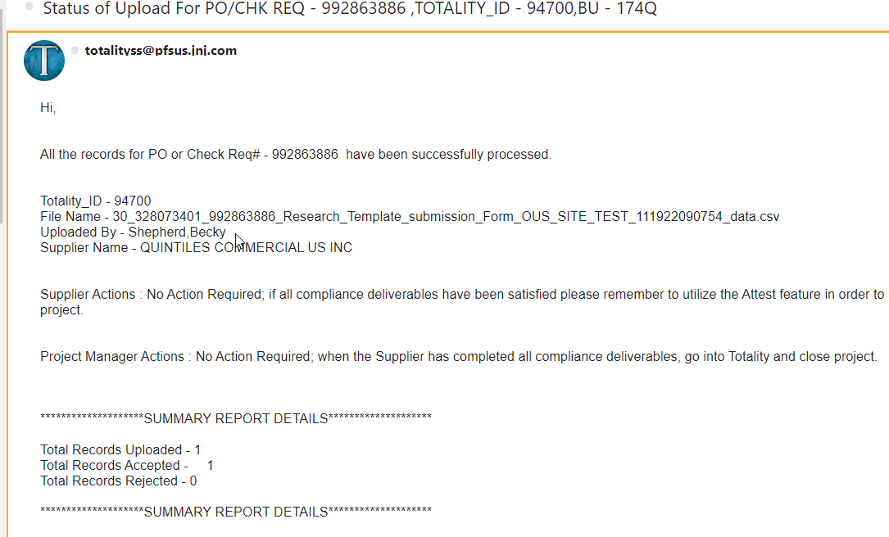
Notification Email: No Errors
Key Points:
Provides confirmation that all the records of the uploaded data template were successfully processed
Provides a summary of the total number of records uploaded and accepted.

Slide 38
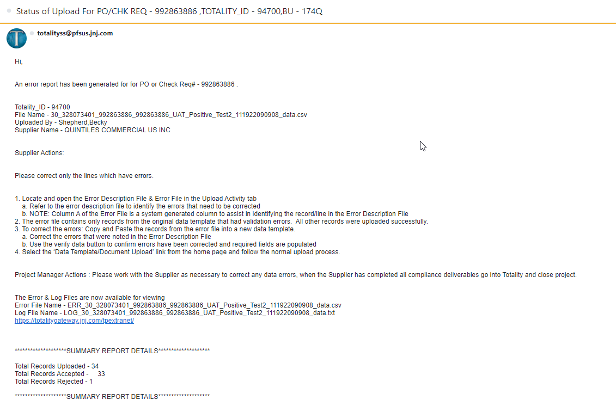
Notification Email: Errors
Key Points:
Notification that some or all the uploaded records failed validation
Provides the number of records in the file that were – Uploaded, Accepted, and Rejected
The names of the Error File and Log File that you will use to correct the errors
Only the individual lines/records of the data template that failed validation will be rejected and require correction. You only need to re-submit the rejected line items.

Slide 39
Correcting Errors
File Uploaded
Upload Status
Error Log File (Text File)
Error File (csv file)
Key Points:
Uploaded Activity Reports are located in the “Upload Activity/Error Reports” section of the Totality Portal
Provides six months of historical upload activity
File Uploads: Original file uploads in .CSV format
Error Files: Error file/logs with description of validation errors
To view your files – select the month/year the file was uploaded and locate the file names from the error notification email

Slide 40
Correcting Errors
Locate and open the Error Description File & Error File in the Upload Activity tab
Refer to the Error Description File to identify the errors that need to be corrected
NOTE: Column A of the Error File is a system generated column to assist in identifying the record/line in the Error Description File
The Error File contains only records from the original data template that had validation errors. All other records were uploaded successfully.
To correct the errors: Copy and Paste the records from the Error File into a new data template.
Correct the errors that were noted in the Error Description File
Use the verify data button to confirm errors have been corrected and required fields are populated
Select the ‘Data Template/Document Upload’ link from the home page and follow the normal upload process.
Provides text description of lines that failed during the validation process
Provides the lines/records from the uploaded template that had errors

Slide 41
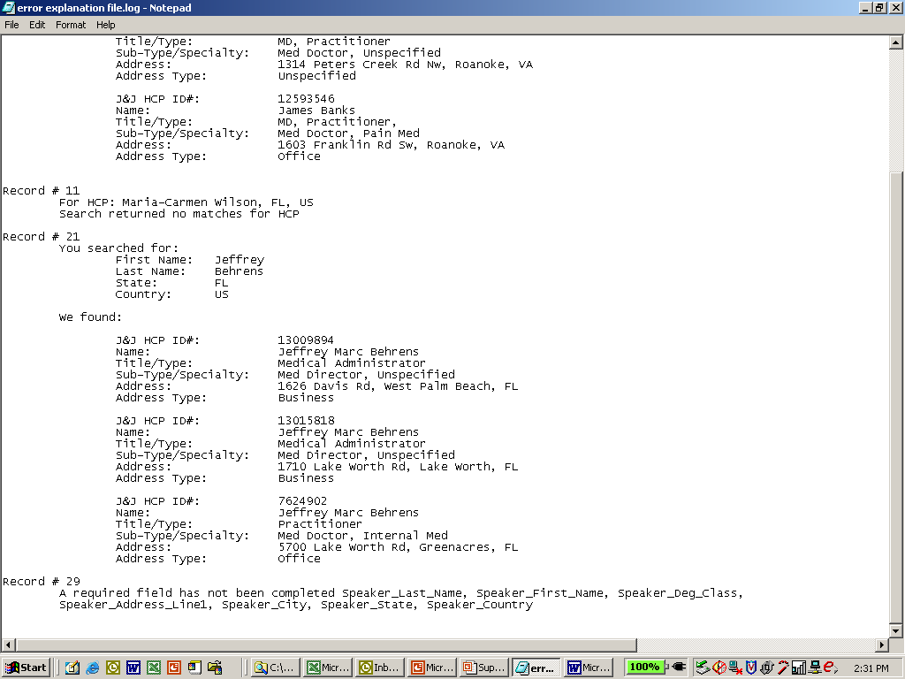
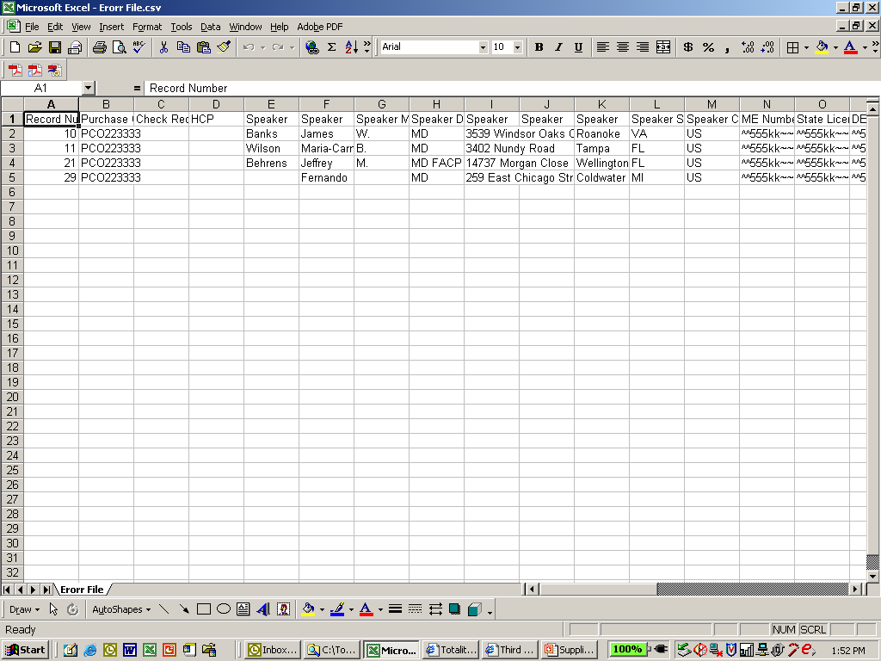
Correcting Errors
Error Description File
Error File
Error File:
Column A provides the record/row number from the original data file that is in error.
You can cross reference this number with the record number in the error description file to identify the validation errors.
REMEMBER to delete column A when resubmitting the corrected file

Slide 42
Correcting Validation Errors: Common Errors
Suppliers Must Ensure
All error logs are rectified.
All data and documentation are uploaded correctly.
Data Deletion is processed for all incorrect or duplicate records.
Supplier has checked for missing, inaccurate, or duplicate data
Invalid Date Formats
HCP Name, City and State does not agree with the J&J HCP ID # supplied
Required fields left blank
Zero was used in a field – always leave blank if no value
PO # must be a numeric 9-digit entry and match the PO # entered on the upload screen
When uploading correction file, file name should be similar but include a v1 or word "correction", etc.
Submission of all data from original template – ONLY lines/records with errors should be resubmitted for processing.
Quick Tips:
Request an Activity/Closeout Report to ensure ALL information uploaded is accurately reflected.
If you continue to receive template errors, try a “fresh” new template and resubmit for processing

Slide 43
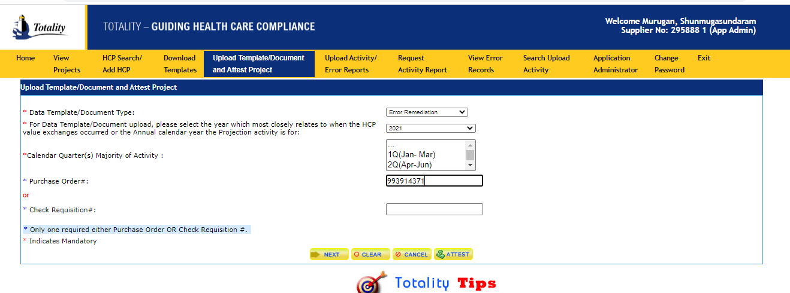
error remediations
Select Error Remediation from the Drop-Down Menu
Select the Year and Quarter of when the HCP Value Exchange Occurred
Enter Purchase Order # or Check Req. #
Click ‘Next’

Slide 44
error remediations
Select the Corrected Data Template file attachment
Check box to remediate applicable file upload
Click Upload

Slide 45
and
error remediations
After remediating all the errors, Purchase Order # or Check Requisitions entered will display below message when selecting “Error Remediation”

Slide 46
Activity Report: Running a Report
Click the ‘Request an Activity Report’ link from the Totality Home Page
Activity Reports contain all information that was previously uploaded via the data templates.
Activity reports can be run at any time to ensure the data uploaded is accurately reflected.
Activity reports MUST be run at the end of a project and prior to attesting to ensure data is accurately reflected prior to project closeout.
Activity Reports are generated by PO # and may include other PO #’s associated with the Totality ID
Enter PO or CR#
Note:
Once submitted, you will receive your activity report within 2-3 hours to the email address associated with your login.

Slide 47
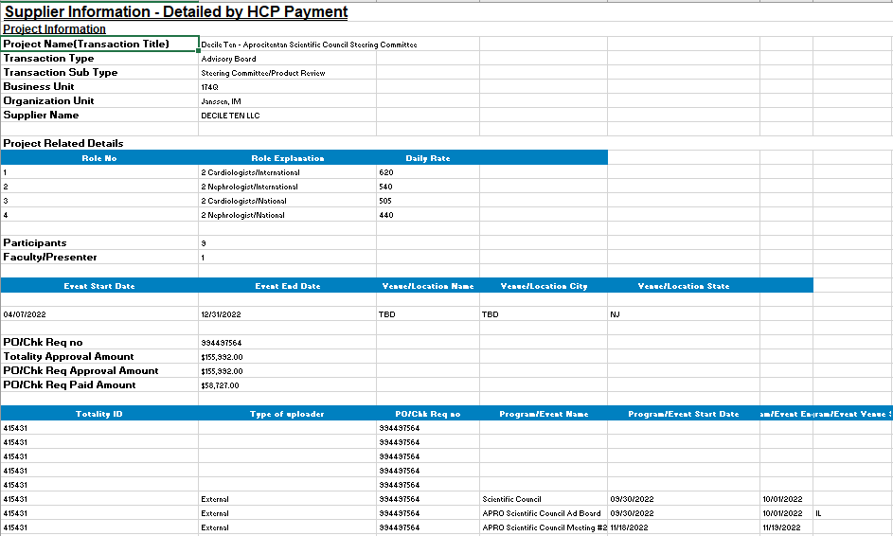
Activity Report: Detail Report View
Details of Individual HCP Expenses – Import to review for the following:
Payment Amounts – review for outlying data that may have been incorrectly entered
Duplicate Data – review line items to ensure no duplicate records were processed
Ensure ALL data is accurately captured and no data is missing
If errors or duplicate data are identified, please notify your J&J Project Manager and complete a “Data Deletion Request Form” located on the Supplier Resource Site, under the ‘Form’ section.
If errors are identified, you will need to complete a new Data Template for those individual lines and resubmit

Slide 48
Upload Review and Data Deletion Process
Supplier Upload Review:
Suppliers are required to review all uploaded data (including templates and supporting documents) for completeness and accuracy, and to ensure that there are no duplicates, and that data is accurate for Federal and State reporting.
Data Deletion:
The HCP data deletion request is processed to remove duplicate and incorrect information that was submitted.
If inaccurate data is identified, suppliers are required to submit a data deletion request and reupload any corrected data.

Slide 49
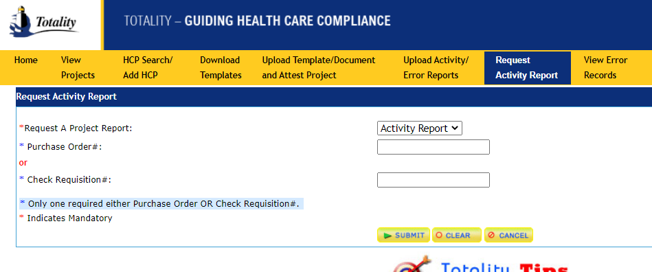
Data Deletion Request Process
“Request an Activity Report” for the project and review to validate that all uploaded HCP data is complete and accurate.
An Activity Report that provides the details of all validated upload activity (and documents) for the project will be emailed within 1 hour.
Go to “Request an Activity Report” tab
Enter Purchase Order # or Check Req. #
Click Submit.

Slide 50
Data Deletion Request Process
Supplier Upload Review:
If errors or duplicate records are identified on the report, complete the Data Deletion Request Form found on the Download Templates section of the Totality Third Party Portal. The Data Deletion Instructions can be found on the same page.

Slide 51
Data Deletion Request Process
Data Deletion:
The HCP data deletion request is processed to remove duplicate and incorrect information that was submitted.
If inaccurate or duplicate data is identified, suppliers are required to submit a data deletion request and reupload any corrected data.
The information needed to complete the form (i.e., File Name, File ID Number and Record Number of each line to be deleted) can be found in the columns at the end of the Activity Report. The Data Deletion Instructions can be found on the Download Templates section of the Totality Third Party Portal.

Slide 52
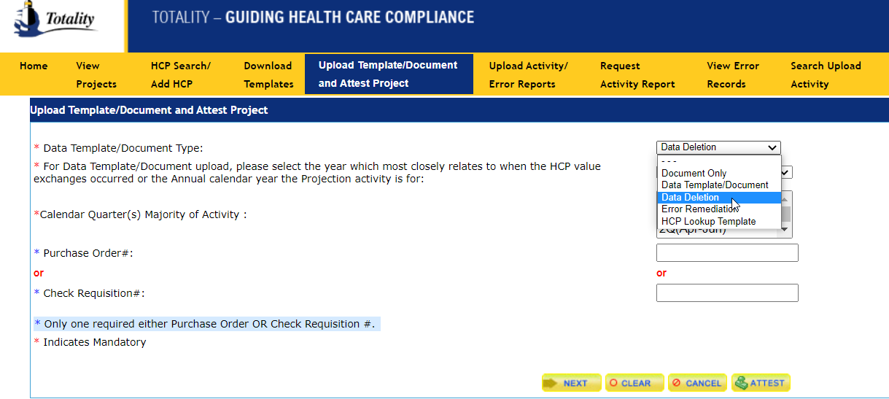
Data Deletion Request Process
Data Deletion Upload
Once you have completed the Data Deletion Request Form, go to the Upload Template/Document and Attest Project Section. Select Data Deletion in the drop-down menu, fill in the Calendar and Purchase Order information, and select Next. You will then be able to select your completed Data Deletion Request Form via the Browse and attach and upload the Form.
Select Data Deletion from the Drop-Down Menu
Select the Year and Quarter of when the HCP Value Exchange Occurred
Enter Purchase Order # or Check Req. #
Click ‘Next’

Slide 53
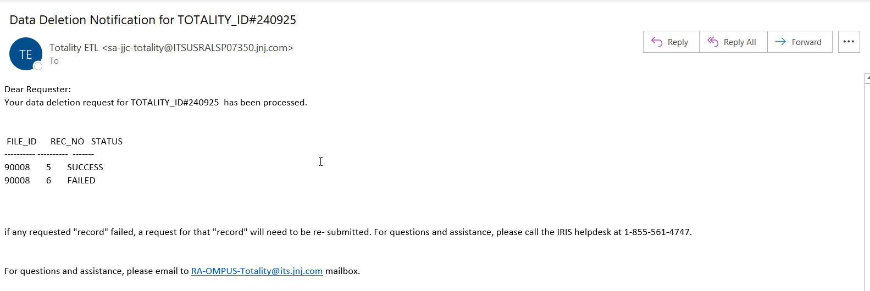
Data Deletion Request Process
Once the data deletion process is completed; the requestor will receive a confirmation email about the completion.
Upon receipt of the email confirmation, the supplier/requestor must re-run the Activity Report to validate the accuracy of the Final data.

Slide 54
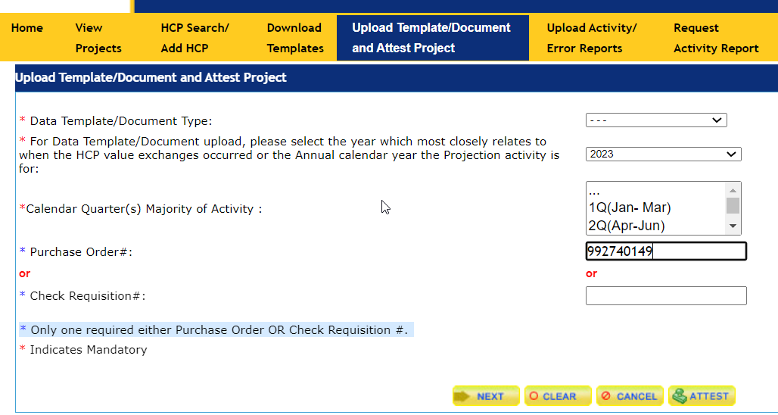
Project Closeout: Supplier Attestation
After compliance deliverables are met, the Supplier must “Attest”
Project Attestation includes two parts:
That you reviewed the Activity Report and all data is complete and accurate
That all compliance related requirements for the project have been met/completed, including attachment of all required compliance documentation
From the Totality Home Page, select the “Data Template/Document Upload and Project Attestation” link
Select the year that most of the activity occurred
Enter PO or CR Number
Click the “Attest” Button

Slide 55
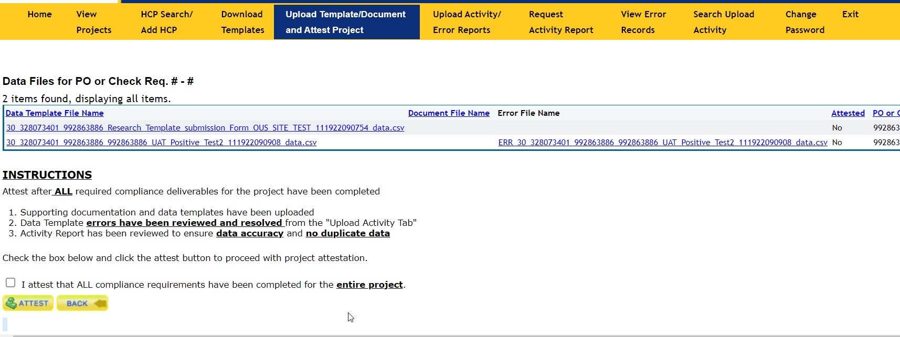
Project Closeout: Supplier Attestation
Once you click “Attest” you will have the ability to view all uploaded documents and whether or not they were previously attested
Uploaded Data Templates
Attestation Status
Mark the Check Box to indicate all compliance requirements have been completed
Select the Attest Button to process with project Attestation
Upon confirmation that ALL deliverables are accurately uploaded, you may “Attest” by checking the box above and click the “Attest” button
Once you attest, the J&J Project Owner will receive a notification that you have attested, and they will review all the documentation to ensure all deliverables are accurately captured

Slide 56
Project Closeout: Closed Project
Closed transactions associated with an individual supplier can be found on the “View Projects” tab within the Totality site
Once a transaction is “Closed”, you will not be able to upload anymore data templates or documents
Suppliers must contact the J&J Project Manager to re-open a project if additional uploads or template data corrections are required

Slide 57
Key Takeaways
Understanding of Totality and your responsibilities as a J&J Supplier
Compliance deliverables with associated timelines
Resources available to make Totality a smooth and compliant process
Supplier Totality Portal (https://totalitygateway.jnj.com/tpextranet/inhome.do)
Supplier Resource Portal (http://www.totalitygatewayresources.com/)
J&J Business Partners (Project Manager, J&J Totality Team)

Slide 58
Resources: J&J Helpdesk Submission
IRIS Help Desk
Contact with technical issues or if you’re receiving any type of system error
Phone: US: 1-855-561-4747
Select language of communication
External user should enter “0” when asked for WWID
Then choose option 4 for Business Application Support after listening to voice prompt; this will connect to Helpdesk assistant. Who will assist in creating a ticket.
Further instruction according to your request will be provided by the Helpdesk assistant.
Screen Shots should be provided when inquiring about error messages received
Email inquiries automatically assigned ‘Medium’ Priority
If request is high priority, add ‘High’ to the subject line
Escalate unanswered emails/voicemails to the HCC Totality Team (your JNJ Totality contact)

Slide 59
Resources: J&J Totality Experts
Totality Project Related Questions:
Your J&J Totality Project Manager
J&J Extranet Resources:
Supplier Totality Portal: https://totalitygateway.jnj.com/tpextranet/
Supplier Resource Portal: http://www.totalitygatewayresources.com/
Totality Process Related Questions:
HCC Totality Support
hcctotalityhelp@its.jnj.com

Slide 60
QUESTIONS

Slide 61
Reference Documents
https://www.fda.gov/inspections-compliance-enforcement-and-criminal-investigations/compliance-actions-and-activities/fda-debarment-list-drug-product-applications
http://www.ama-assn.org/ama/pub/education-careers/becoming-physician/medical-licensure/state-medical-boards.page
http://exclusions.oig.hhs.gov/
https://sam.gov/content/exclusions

Slide 62
THANK YOU

